Slide 1
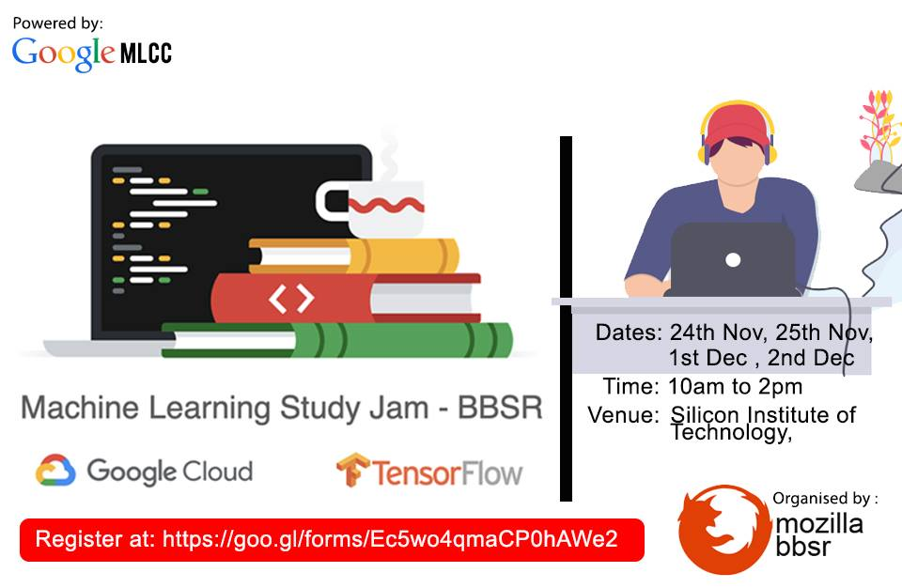

Slide 2
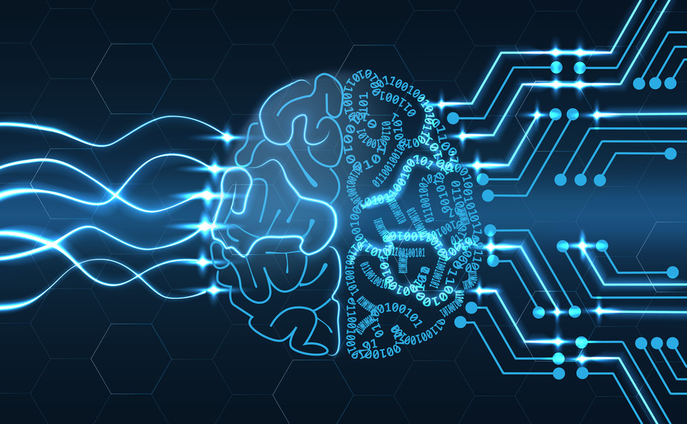
Rohan Saha

Slide 3
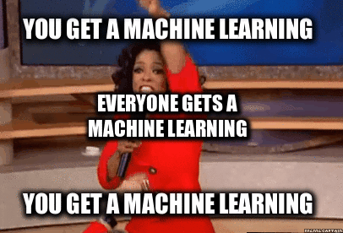
Why Machine learning?
It changes how you think.
Identify faces
Automate tasks
Solve un-programmable tasks

Slide 4

Various disciplines
Machine Learning
Mechatronics
Neuroscience
Mathematics
Biology
Psychology
Computer science
Don’t worry, you don’t need to know everything.

Slide 5

Framing
Supervised Learning
Model
Training
Predict
Provide Data
Example -
A row in the dataset (Features, Labels)

Slide 6
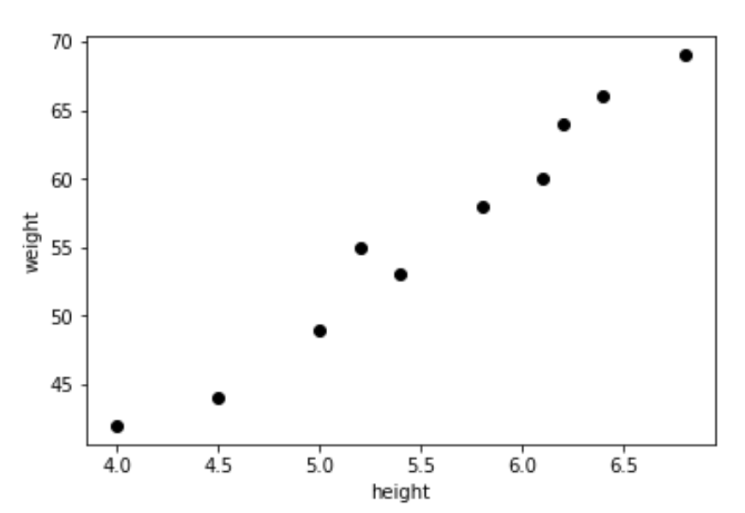
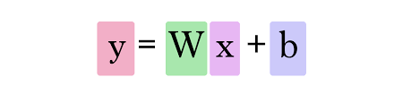
Descending into ML
Linear Regression = Curve fitting
What is loss?

Slide 7
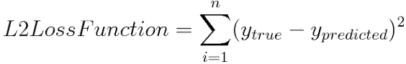
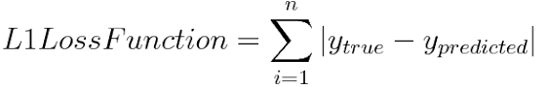
Loss
Reduce
But how do you reduce it?

Slide 8
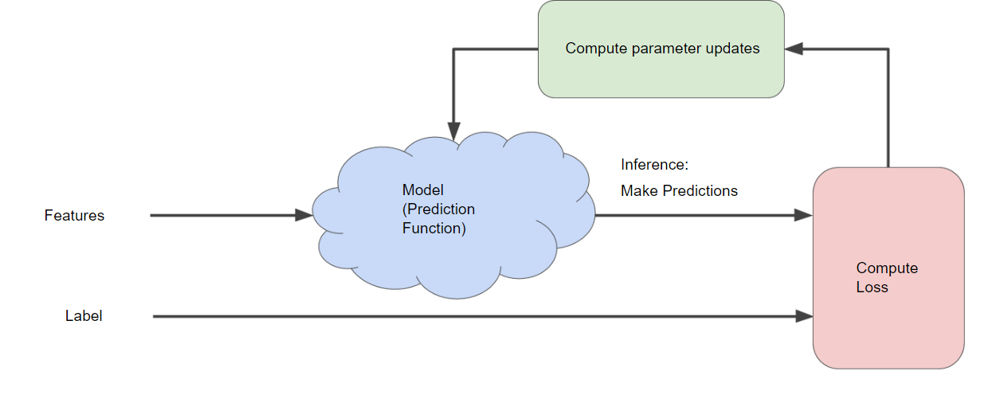
Compute gradient

Slide 9
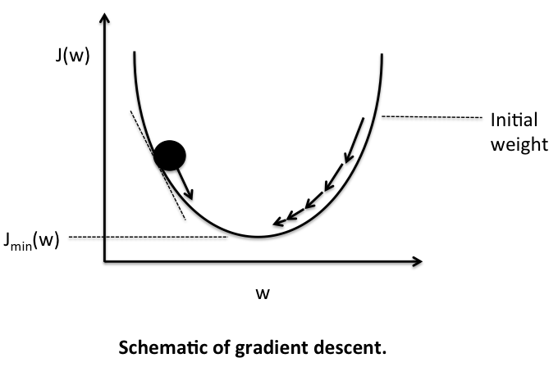
A visual approach
Learning Rate
Parameters (W)
J(W)
Loss

Slide 10
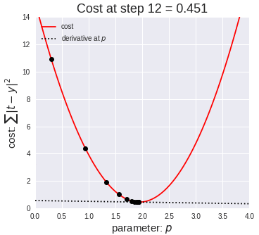
Batch Gradient Descent
Stochastic Gradient Descent
Mini-batch Gradient Descent

Slide 11
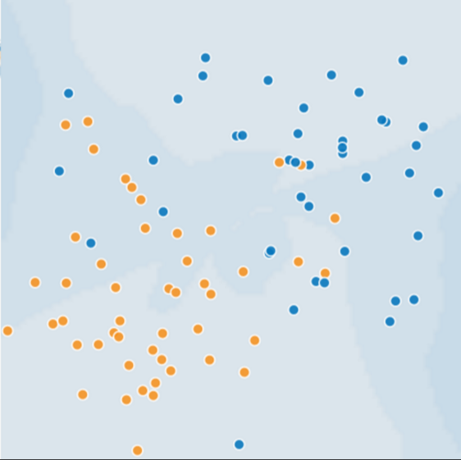

Generalization
Always try to make the model generalized.
Overfitting is not desirable.
One way to generalize the model is to randomize the training set.

Slide 12

Training and Test Set
80%
20%
More training data– Good model
More testing data – Good confidence
Never train on test data

Slide 13
Break Time (15 minutes)

Slide 14


Validation
60
20
20
Training – 60%
Validation – 20%
Test - 20%

Slide 15
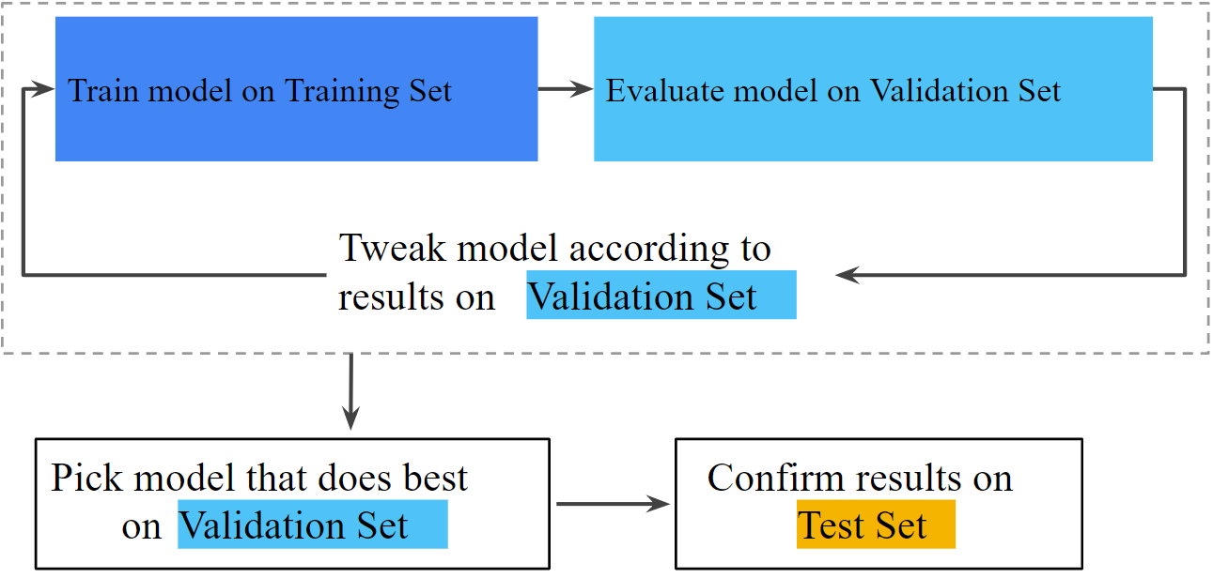
Workflow

Slide 16
Representation
Format
Numerical
Categorical
One hot encoding
e.g. 1,2,3,0.4,0.6 etc.
e.g. France, Germany, Dog etc.
[0,0,1]
[0,1,0]
[1,0,0]

Slide 17
Feature Engineering
Tips
Properties of a good feature
Obvious, clear meaning
Not sparse
Should be constant over time
Should not have outliers
Always visualize
Pre-process your data
Monitor your data

Slide 18
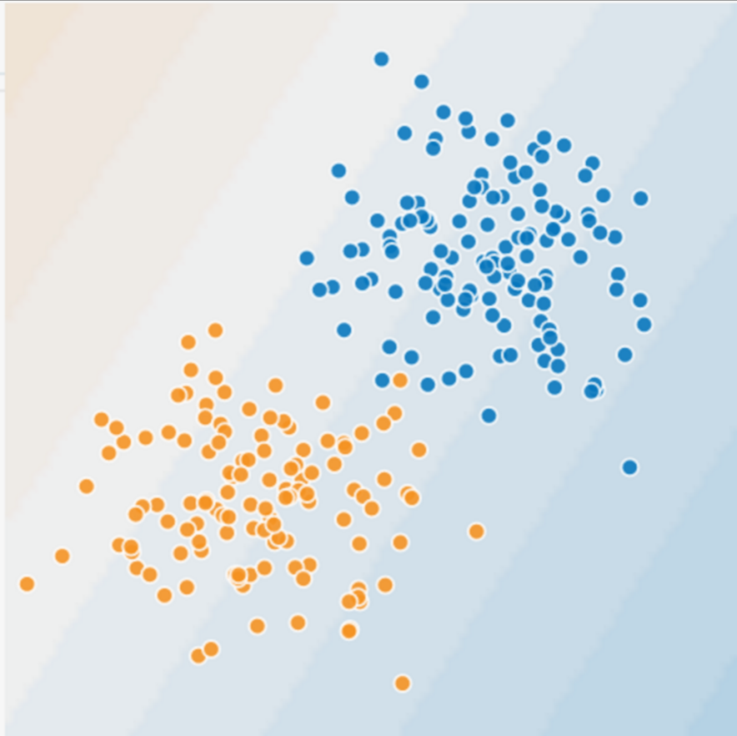
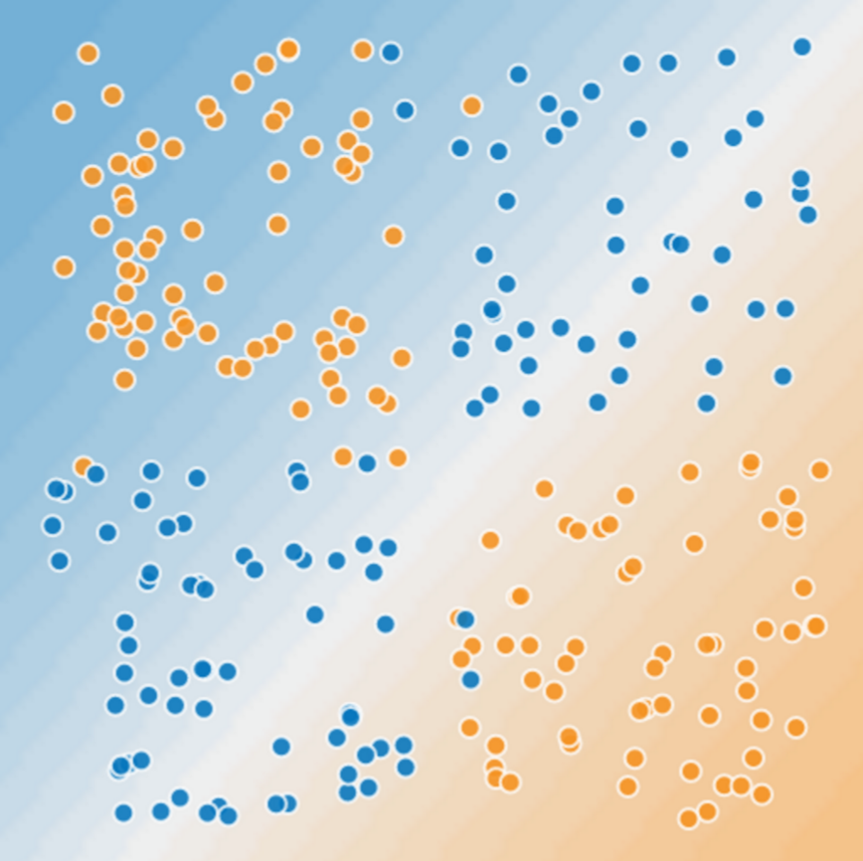
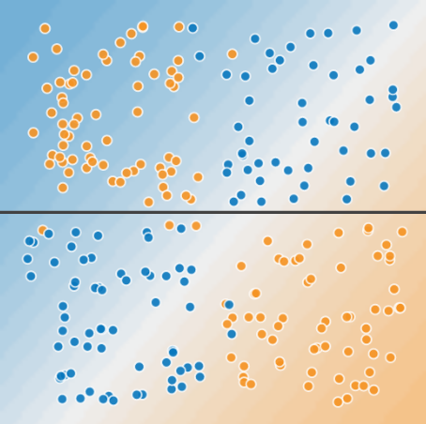
Feature crosses
Feature Cross = Synthetic feature = x₁x₂ = x₃

Slide 19
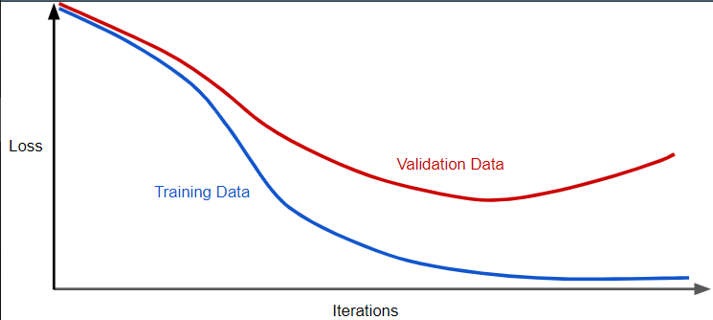
Regularization

Slide 20
L2 Regularization
Large lambda – Simple model but under fitting may occur.
Small lambda – Complex model and risk of overfitting (less generalization capability).

Slide 21

Time to code

Slide 22

Google Colaboratory
Project by Google
Open source
Similar to Jupyter notebook
Web-based
Pre-installed with libraries

Slide 23

Allows for easy and fast prototyping
Supports both convolutional networks and recurrent networks
Runs seamlessly on CPU and GPU
Keras is a high-level neural networks API, written in Python and capable of running on top of TensorFlow, CNTK, or Theano

Slide 24
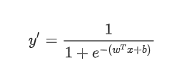
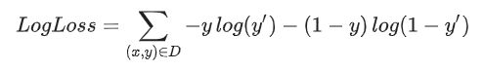
Logistic Regression
A method for binary classification.
For example, you can try to classify cats and dogs.
Squared loss does not work here.

Slide 25
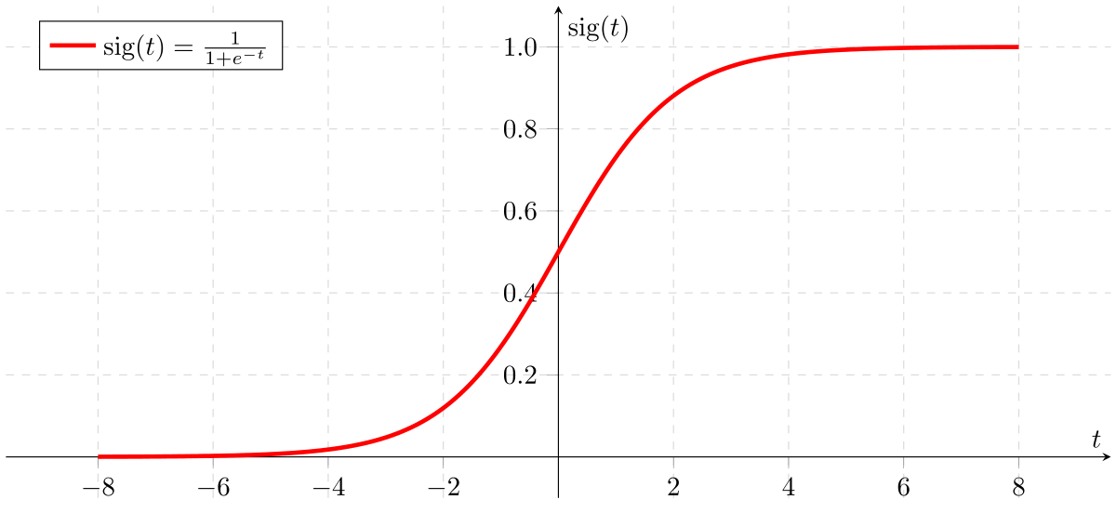

Slide 26
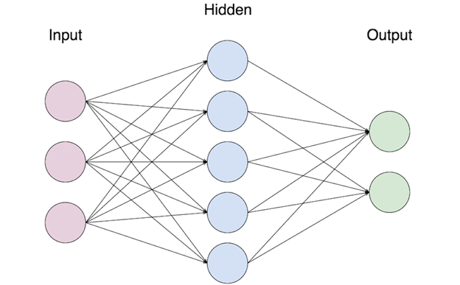
Neural Networks
A single hidden layer neural network.

Slide 27

A neuron

Slide 28
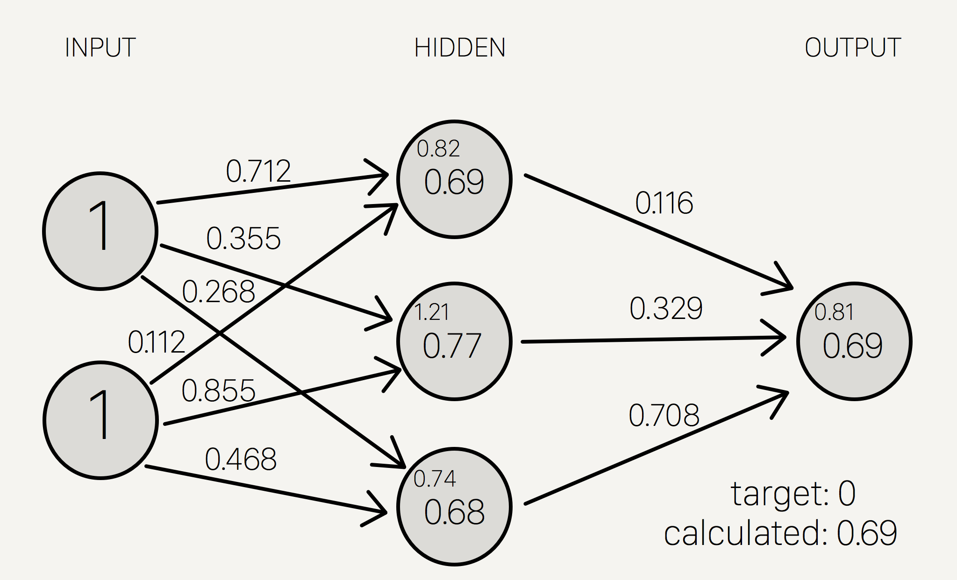

Slide 29
Training neural networks
Forward Propagation
Backward Propagation
Propagate the weights forward.
Make a prediction.
Calculate loss.
Calculate gradient.
Adjust the weights.
Repeat forward propagation.

Slide 30
Basic pipeline for ML problems
Import libraries
Import data
Preprocess Data
Optimize
Train the model
Create the model
Visualize
Predict

